Slide 1


GM University
Davanagere
Dr. Kiran M S
Assistant Professor
Department of Chemistry
Notes:
GM University

Slide 2
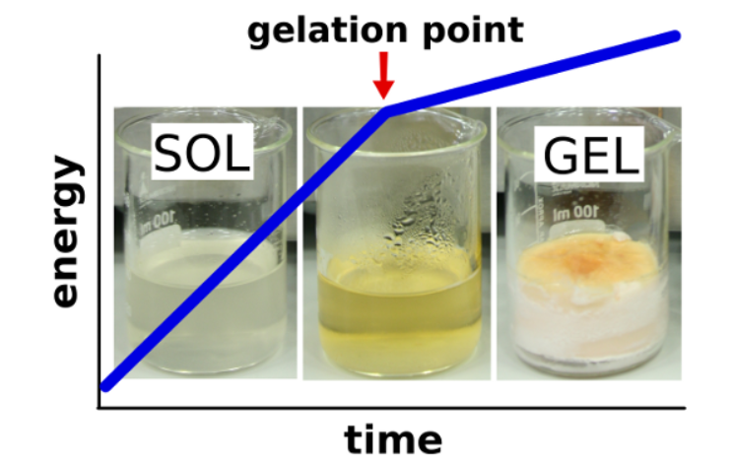
Sol-Gel method
Sol : Is a type of colloid in which solid particles are suspended in a liquid
Gel: Semi rigid mass which is obtained after polycondensation.

Slide 3
Synthesis by Sol-Gel method
Sol-gel method of synthesizing Nanomaterials is very popular amongst chemists and is widely employed to prepare oxide Nanomaterial.
The sol-gel process can be characterized by a series of distinct steps.

Slide 4
1) Preparation of sol : A stable colloidal solution called sol is prepared. (The sol is a liquid suspension of solid particles ranging in size from 1nm to 1 micron). It is prepared by hydrolysis and partial condensation of precursors such as metal alkoxide.
Sodium methoxide : CH₃ONa
Titanium isopropoxide : (Ti(O-iPr)₄) /
Ti{OCH(CH₃)₂}₄
Zirconium ethoxide : Zr(OC₂H₅)₄
Hydrolysis
Condensation

Slide 5
2) Conversion of Sol to Gel: Further condensation of sol into a three-dimensional network, produce a gel material
3) Aging of the Gel: Polycondensation reaction continues until the gel transforms into a solid mass accompanied by contraction of the gel networks and expulsion of solvent from gel pores. The aging process of gels can exceed 7 days.

Slide 6
4) Drying of Gel: Water and other volatile liquids are removed from the gel network.
5) Dehydration: To stabilize the gel against any dehydration the surface-bound M-OH groups are removed by calcining (heating) the monolith at temperature up to 800 C.

Slide 7
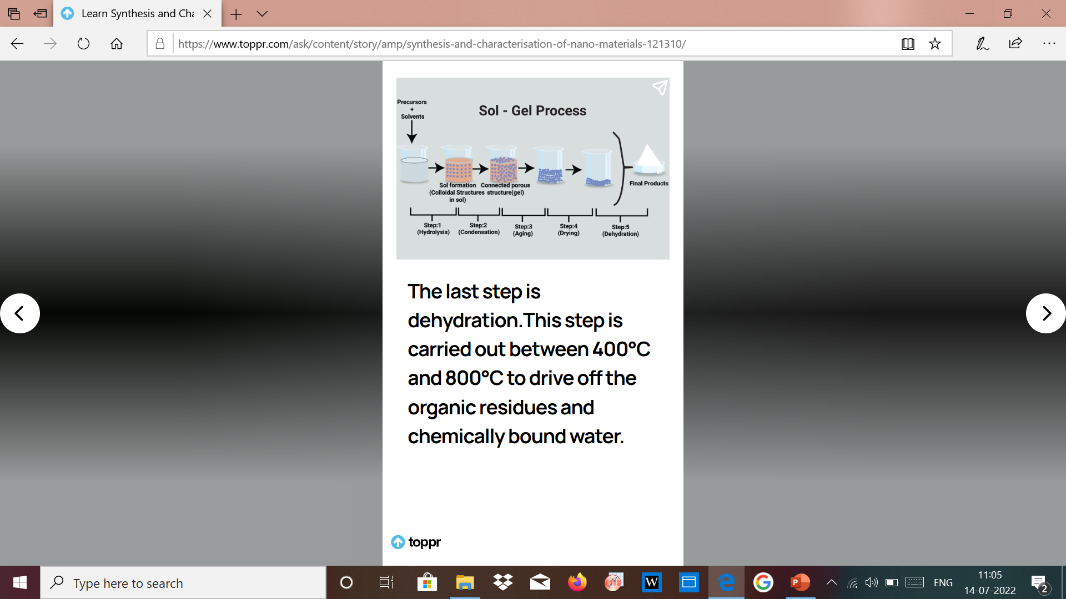

Slide 8
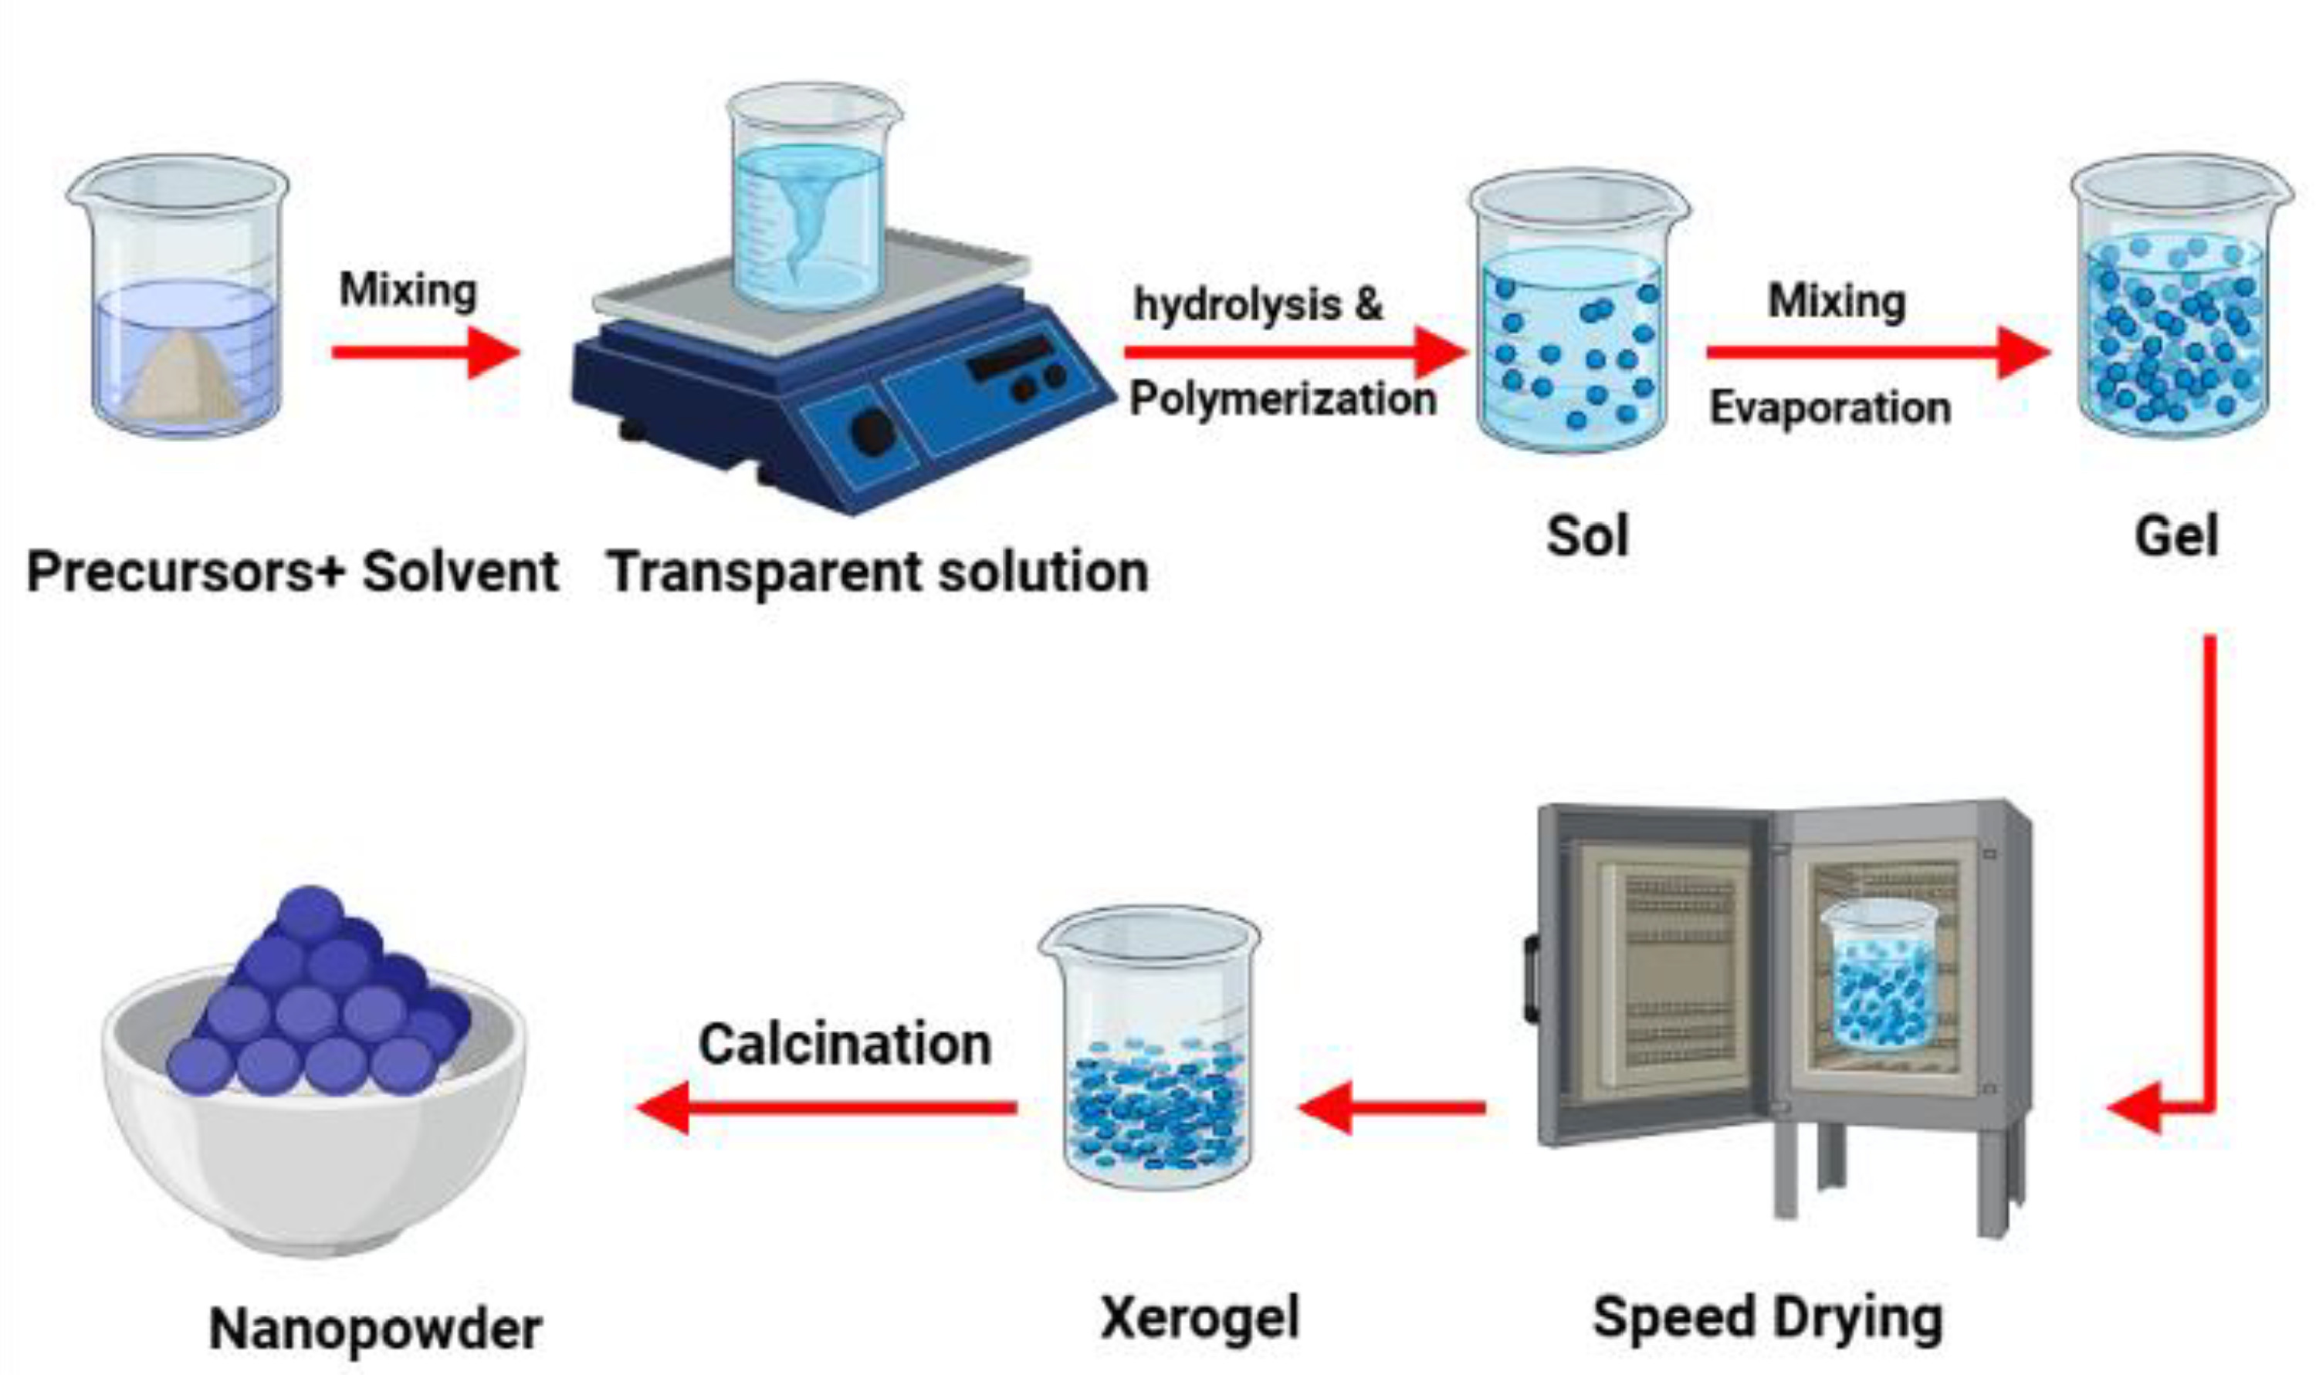

Slide 9
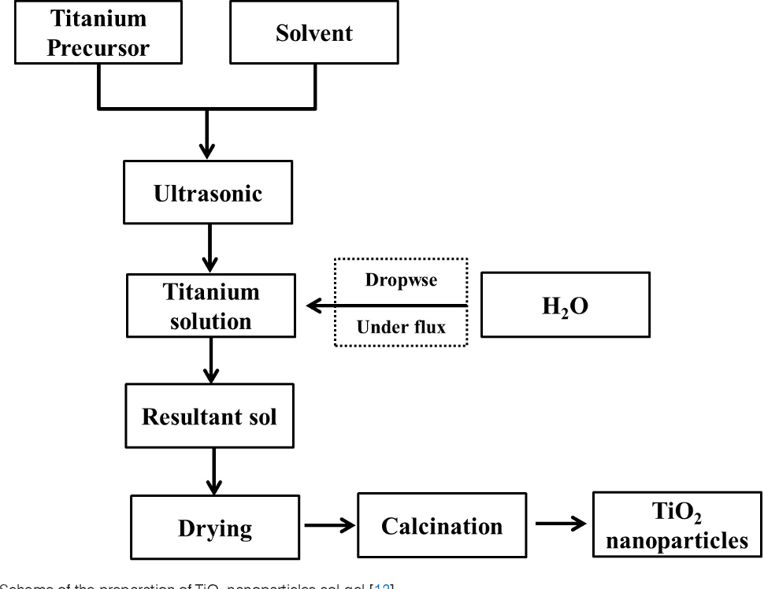

Slide 10
Advantages:
Reaction carried out at a lower temperature
Easy reactions (water) to be carried
Simple and rapid method
Disadvantages:
Quite expensive
Since several steps are involved, close monitoring of the process is needed

Slide 11
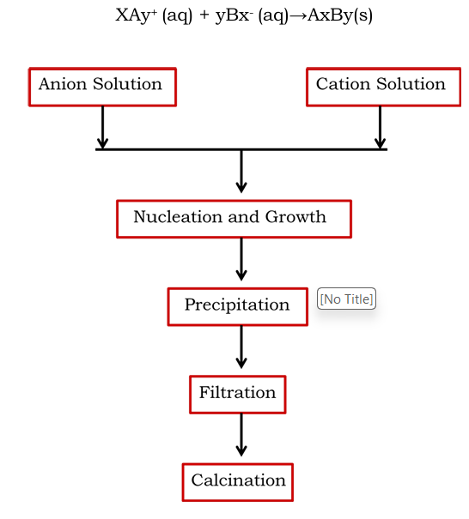
Co-precipitation method

Slide 12
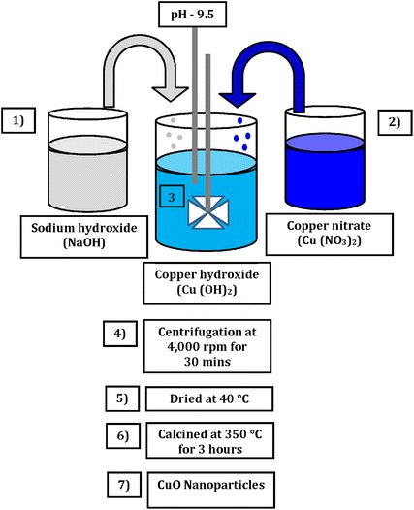

Slide 13
Advantages of Co-precipitation method
Simple and rapid preparation.
Easy control of particle size
Low- temperature
Energy efficient.
Disadvantages of Co-precipitation method
Not applicable to unchanged species.
Trace impurities may also get precipitated with product. This method does not work well if the reactants have very different precipitation rates.

Slide 14
Thank you

